Slide 1
Online Chatbot based ticketing System
PIP2001 Capstone Project
Final Review-4
Batch Number:
Under the Supervision of,
Mr.Tanveer Ahmed
Assistant Professor
School of Computer Science and Engineering
Presidency University
Roll Number 20211CIT0036 20211CIT0192 20211CIT0024 20211CIT0190 | Student Name Uluva Anji Chamanthula Hemanth T Swamynadh K Anil Kumar
Name of the Program:
Name of the HoD: Dr. Anandaraj S P
Name of the Program Project Coordinator: Dr. Sharmasth Vali Y
Name of the School Project Coordinators: Dr. Sampath A K / Dr. Abdul Khadar A / Mr. Md Ziaur Rahman

Slide 2
Introduction
Traditional museum ticketing systems often face inefficiencies such as long queues, booking errors, and poor accessibility, leading to frustration among visitors. Manual ticketing requires significant human effort, increasing operational costs and reducing overall efficiency.
To address these challenges, this project proposes an AI-powered chatbot-based ticketing system that automates the booking process, integrates a secure payment gateway, and offers multilingual support. The chatbot will provide 24/7 availability, real-time booking confirmation, and data-driven analytics to improve visitor experience and museum management.
By leveraging Natural Language Processing (NLP) and AI, this system ensures error-free ticketing, reduced wait times, and seamless interaction, making the museum visit more convenient and accessible for a diverse audience.

Slide 3
Literature Review
sno | Author Name | Title | Publication Date | Summary | Extracted Information
1 | E. Adamopoulou and L. Moussiades | "Chatbots: History, Technology, and Applications“ | 2020 | This paper provides a comprehensive overview of chatbot development, including their historical evolution, underlying technologies, and various applications across industries. It discusses the integration of Natural Language Processing (NLP) and Artificial Intelligence (AI) in creating effective conversational agents. | Offers foundational knowledge on chatbot technologies, beneficial for understanding the technical aspects of implementing a chatbot-based ticketing system.
2 | A. Borda, G. Gaia, and S. Boiano | "Enhancing User Experience with AI-Based Chatbots: A Study on Museum Visitors" | 2019 | This study explores the application of AI chatbots in museums to engage visitors. It presents a case study involving the design and implementation of a chatbot aimed at enhancing the educational experience of museum-goers. | Provides insights into user interaction design and the educational potential of chatbots in a museum context.
3 | S. Schaffer, O. Gustke, J. Oldemeier, and N. Reithinger | "Towards Chatbots in the Museum" | 2018 | This paper discusses the development of a chatbot designed for museum environments, focusing on enhancing visitor engagement through interactive user interfaces. The study explores information processing, multimodal intent detection, and dialog management tailored to museum contexts. | Information: Provides insights into the technical challenges and solutions in implementing chatbots within museums, emphasizing the importance of context-aware information delivery and user interaction.
4
5
6

Slide 4
sno | Author Name | Title | Published year | Summary | Information extracted
4 | S. K. Jain, R. Kumar, and S. K. Sharma | Robotic Process Automation: In-Depth Analysis of Advanced Automation Techniques and Technologies | 2018 | This survey examines the deployment of chatbots in customer service, focusing on the use of deep neural networks to enhance interaction quality. It evaluates various architectures and methodologies employed to improve user satisfaction and operational efficiency. | Provides insights into advanced neural network techniques applicable to developing sophisticated chatbot functionalities for ticketing systems.
5 | H. S. Munawar, M. A. Khan, and S. U. Khan | "Design and Implementation of an Intelligent Chatbot System for E-commerce" | 2019 | The paper discusses the creation of an intelligent chatbot tailored for e-commerce platforms, emphasizing seamless user interaction and transaction processing. It highlights the system's architecture, integration challenges, and solutions to enhance user engagement. | Offers practical guidance on integrating chatbots with payment gateways, relevant to developing a ticketing system with secure transaction capabilities.

Slide 5
sno | Author Name | Title | Published year | summary | Information Extracted
6 | L. Wang, Y. Chen, and X. Liu | "Multilingual Chatbot for Museum Information Retrieval" | 2021 | This research focuses on developing a multilingual chatbot to assist museum visitors in retrieving information. It addresses language processing challenges and evaluates the system's effectiveness in enhancing visitor experience. | Provides valuable information on implementing multilingual support in chatbots, crucial for accommodating diverse museum audiences.
7 | P. Kumar and M. Sharma | "Chatbot-Based Natural Language Interface for Online Ticketing System" | 2020 | The paper presents the development of a chatbot with a natural language interface designed for online ticketing. It discusses the system's architecture, NLP integration, and the challenges faced during implementation. | Highlights the practical aspects of developing a chatbot-based ticketing system, including user interaction and system integration.

Slide 6
Existing method Drawback
Long Queues & Waiting Time – Manual ticketing causes delays, especially during peak hours.
Human Errors – Mistakes in issuing tickets, double bookings, or lost records can occur.
Limited Accessibility – Visitors with disabilities or language barriers face difficulties.
High Operational Costs – Hiring and training ticketing staff increase expenses.
Inconvenient Payment Process – Manual payment handling leads to inefficiencies and security risks.
Lack of Data Analytics – No insights into visitor trends, peak times, or sales reports.
Limited Availability – Ticket counters have restricted working hours.
Poor Customer Engagement – No interactive support or real-time updates for visitors.

Slide 7
Proposed Methodology
Chatbot Integration – Develop an AI-powered chatbot using Dialogflow, Rasa, or OpenAI API for automated ticket booking.
Natural Language Processing (NLP) – Enable chatbot to understand user queries in multiple languages for better interaction.
Real-Time Ticket Booking – Implement a system that checks ticket availability and confirms bookings instantly.
Secure Payment Gateway – Integrate Razorpay, PayPal, or UPI for seamless and secure transactions.
User Authentication & Profile Management – Implement OAuth/Firebase authentication to store user history and preferences.
Admin Dashboard – Provide a control panel for museum staff to manage bookings, analytics, and reports.
Data Analytics & Reporting – Track visitor trends, peak hours, and revenue insights to optimize museum operations.

Slide 8
Objectives
Automate Ticket Booking – Reduce reliance on manual ticket counters.
Eliminate Long Queues – Ensure faster ticket processing through an AI chatbot.
Enhance User Experience – Provide a seamless and intuitive booking process.
Enable Multilingual Support – Cater to a diverse range of visitors.
Improve Operational Efficiency – Reduce human errors and dependency on staff.
Integrate Secure Payment Gateways – Enable cashless transactions.
Provide Real-Time Booking Confirmation – Ensure instant ticket issuance.
Offer 24/7 Availability – Allow users to book tickets anytime, anywhere.
Reduce Maintenance Costs – Minimize expenses on staffing and physical infrastructure.
Implement Data Analytics – Track visitor behavior and optimize resources.
Enhance Museum Promotion – Provide personalized offers and event updates via chatbot.
Ensure High Scalability – Allow integration with new exhibits, shows, and museums.

Slide 9
Methodology/Modules
The development of the AI-powered chatbot-based ticketing system follows a structured approach, ensuring efficiency, reliability, and scalability. Below are the key steps involved:
1. Requirement Analysis & Planning
Identify the functional and non-functional requirements.
Analyze the existing manual ticketing system's drawbacks.
Define the scope, objectives, and expected outcomes.
2. System Design & Architecture Development
Design the system architecture (frontend, backend, database, and chatbot integration).
Select appropriate technologies (Python, ReactJS, NLP frameworks, cloud services, payment gateway).
Develop a database schema for managing bookings, users, and analytics.
3. Chatbot Development & NLP Integration
Implement a chatbot using Dialogflow, Rasa, or OpenAI API for natural conversation.
Train the chatbot with museum-related FAQs, ticketing queries, and booking commands.
Enable multilingual support for global accessibility

Slide 10
Continued…
4.Ticket Booking System Development
Implement real-time ticket availability checking.
Develop a secure booking process with user authentication.
Integrate QR code-based digital ticket generation for easy validation at entry.
5. Payment Gateway Integration
Implement secure transactions using Razorpay, PayPal, Stripe, or UPI.
Ensure compliance with PCI DSS security standards.
Provide multiple payment options (credit/debit cards, net banking, mobile wallets).
6. User Authentication & Profile Management
Implement login/signup using OAuth (Google, Facebook, Email, Mobile OTP).
Enable users to manage booking history, refunds, and upcoming tickets.
7. Admin Dashboard Development
Design an admin panel for ticket management, cancellations, and analytics.
Provide role-based access control for museum staff.

Slide 11
Continued…
8. Data Analytics & Reporting Module
Track visitor trends, peak hours, and booking patterns.
Generate reports for museum management to optimize resources.
9. Testing & Quality Assurance
Conduct unit testing, integration testing, and system testing.
Perform load testing to ensure chatbot scalability under high traffic.
Fix bugs and optimize system performance.
10. Deployment & Maintenance
Deploy the system on cloud platforms (AWS, Firebase, or Azure) for scalability.
Monitor real-time performance and improve chatbot interactions.
Regular updates and enhancements based on user feedback.

Slide 12
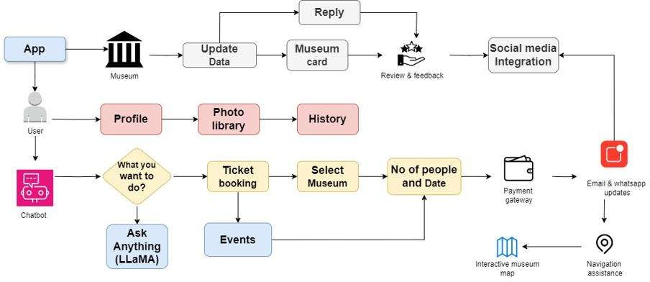
Architecture

Slide 13
Hardware/software components
Software Requirements:
Frontend: ReactJS / HTML-CSS-JS
Backend: Python (Flask/Django)
Chatbot: Dialogflow / Rasa / OpenAI API
Database: MySQL / Firebase
Payment Gateway: Razorpay / PayPal / Stripe
Hardware Requirements:
Server: 8GB RAM, 4-core CPU, 50GB SSD
Client Device: PC/Mobile/Tablet with internet
Network: Stable connection for real-time processing

Slide 14
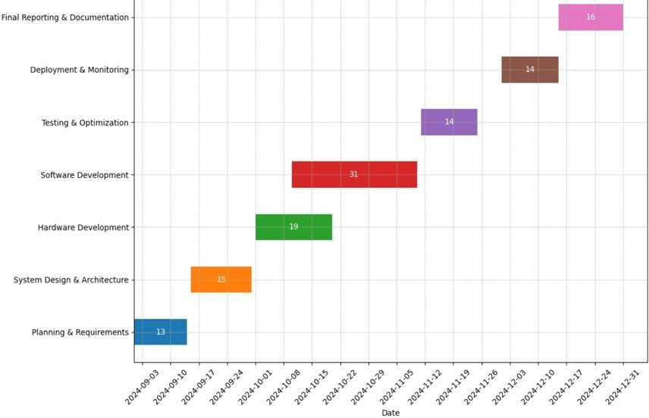
Timeline of Project

Slide 15
Expected Outcomes
Fully Automated Ticketing System – Eliminates the need for manual ticket counters.
Reduced Waiting Times – Allows instant ticket booking, reducing queues at museums.
Improved Customer Experience – Provides an interactive chatbot interface for seamless booking
Multilingual Support for Global Visitors – Enables communication in multiple languages.
Secure & Hassle-Free Payments – Ensures safe transactions with multiple payment options.
Real-Time Booking Confirmation – Instantly generates and shares digital tickets via QR codes.
24/7 Availability – Allows users to book tickets anytime, even outside working hours.
Operational Cost Reduction – Minimizes staffing and infrastructure costs for ticketing.
Data-Driven Decision Making – Provides insights into visitor behavior, peak times, and sales trends.
Scalable & Future-Ready System – Can be expanded to other museums, exhibitions, and events

Slide 16
Conclusion
The proposed AI-powered chatbot-based ticketing system will modernize museum operations by automating the ticket booking process, reducing long queues, and enhancing the visitor experience. By integrating natural language processing (NLP), multilingual support, and secure payment gateways, the system ensures smooth, hassle-free, and 24/7 ticket reservations.
This solution significantly reduces human errors, operational costs, and delays, leading to improved efficiency. The data analytics module provides valuable insights into visitor trends, helping museum management make informed decisions. Additionally, QR code-based digital tickets improve entry management, ensuring seamless access for visitors.
By leveraging cutting-edge AI and cloud-based technology, this system is scalable, secure, and future-ready, making it a benchmark for modern museums and cultural institutions worldwide.

Slide 17
Github Link
The Github link provided should have public access permission.
Github Link:
https://github.com/Anjiuluva7/Online-Chatbot-based-Ticketing-System

Slide 18
References
Chatbots in Museums: Is Visitor Experience Measured.This paper explores the evaluation of user experience with chatbot applications in museums and galleries.
https://intapi.sciendo.com/pdf/10.2478/cjot-2022-0002
2. Engaging Museum Visitors with AI: The Case of Chatbots.This chapter discusses the application of artificial intelligence in museums, focusing on the development and use of chatbot technologies to engage audiences.
https://www.researchgate.net/publication/336020755_Engaging_Museum_Visitors_with_AI_The_Case_of_Chatbots
3. Enhancing Art Museum Experience With a Chatbot Tour Guide.This project utilized a chatbot based on ChatGPT as a tour guide, aiming to enhance visitor engagement and information accessibility in art museums.
https://www.diva-portal.org/smash/get/diva2%3A1885513/FULLTEXT01.pdf

Slide 19
Continued….
Chat-Bot Based Ticketing System Using Dialogflow and Llama LLM.This research presents a chatbot-based ticketing system utilizing Dialogflow and Llama LLM, highlighting the integration of conversational AI in ticketing processes.
https://www.ijraset.com/research-paper/chat-bot-based-ticketing-system-using-dialogflow-and-llama-llm
Chatbot-Mediated Technology to Enhance Experiences in Historical Museums.This study aimed to enhance visitor engagement and interactions with historical textile exhibits in small museums by implementing a Hand-i-Craft Bot.
https://www.tandfonline.com/doi/full/10.1080/23311983.2024.2396206
Designing Reenacted Chatbots to Enhance Museum Experience.This research investigates how chatbots impact history education and improve the overall museum experience based on their appearance and language style.
https://www.tandfonline.com/doi/full/10.1080/23311983.2024.2396206

Slide 20
IEEE Reference Papers
https://ieeexplore.ieee.org/document/9964700/
https://ieeexplore.ieee.org/document/8576921/
https://ieeexplore.ieee.org/document/10126199/
https://ieeexplore.ieee.org/document/9312710/
https://ieeexplore.ieee.org/document/10543301/
https://ieeexplore.ieee.org/document/8665692/

Slide 21
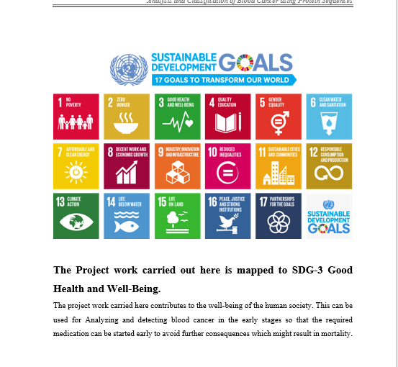
Project work mapping with SDG

Slide 22
Thank You

